Slide 1
Personal Protective Equipment (PPE) and coronavirus

Slide 2
Personal Protective Equipments (PPEs) are protective gears designed to safeguard the health of workers by minimizing the exposure to a biological agent.
Healthcare workers rely on personal protective equipment to protect themselves and their patients from being infected and infecting others.
Components of PPE:
Components of PPE are goggles, face-shield, mask, gloves, coverall/gowns (with or without aprons), head cover and shoe cover.

Slide 3
PPE categories
PPE Category | Category Description | Above-the-neck PPE Product Examples
Category I | Simple PPE (PPE designed to protect users against minimal risks) | Sweatbands Cold Weather Hood System Sun Capes
Category II | Intermediate PPE (PPE not covered within category I or III) | Safety spectacles Industrial helmets Bump caps
Category III | Complex PPE (PPE falling under this category includes exclusively the risks that may cause very serious consequences such as death or irreversible damage to health) | Respiratory PPE Industrial helmets claiming Molten Metal and Electrical Resistance(EU) 2016/425 PPE Regulation change: Hearing Protection

Slide 4
Gloves
Nitrile gloves are preferred over latex gloves because they resist chemicals, including certain disinfectants such as chlorine. There is a high rate of allergies to latex and contact allergic dermatitis among health workers. However, if nitrile gloves are not available, latex gloves can be used. Nonpowdered gloves are preferred to powdered gloves.

Slide 5
EXAMINATION GLOVES
The specification is for the non-sterile and sterile gloves examination gloves made from nitrile, vinyl, latex, or any other suitable material.
Must be miniumum of
All products must be powder free.
All products must have a shelf life of at least 3 years from date of manufacture and 2 years on delivery.
The inner glove box should fit neatly into a standard size glove dispensing unit
 | Gloves made of Rubbers (e.g. Latex) | Gloves made of Thermoplastics (e.g. Vinyl)
Force at Break (Newtons) | ≥ 6.0 | ≥ 3.6

Slide 6
Goggles
With transparent glasses, zero power, wellfitting, covered from allsides with elastic band/or adjustable holder.
Good seal with the skin of the face
Flexible frame to easily fit allface contours without too much pressure
Covers the eyes and the surrounding areas and accommodates for prescription glasses
Fog and scratch resistant
Adjustable band to secure firmly so as not to become loose during clinical activity
Indirect venting to reduce fogging
May be re-usable (provided appropriate arrangementsfor decontamination are in place) or disposable
Quality compliant with the below standards, or equivalent: a. EU standard directive 86/686/EEC, EN 166/2002 b. ANSI/SEA Z87.1-2010.

Slide 7
Face Shield
Made of clear plastic and provides good visibility to both the wearer and the patient
Adjustable band to attach firmly around the head and fitsnuggly against the forehead
Fog resistant (preferable)
Completely covers the sides and length of the face
May be re-usable (made of material which can be cleaned and disinfected) or disposable
Quality compliant with the below standards, or equivalent: a. EU standard directive 86/686/EEC, EN 166/2002 b. ANSI/SEA Z87.1-2010

Slide 8
Masks
The droplet precautions/airborne precautions using masks are crucial while dealing with a suspect or confirmed case of COVID-19/performing aerosol generating procedures.
Two types of masks which are recommended for various categories of personnel working in hospital or community settings, depending upon the work environment:
1. Triple layer medical mask
2. Respirator mask:
N95, FFP2, unvalved FFP2, valved FFP3, unvalved FFP3 valved.

Slide 9
Coverall/Gowns
Coverall/gowns are designed to protect torso of healthcare providers from exposure to virus.
Impermeable to blood and body fluids • Single use • Avoid culturally unacceptable colors e.g. black • Light colors are preferable to better detect possible contamination • Thumb/finger loops to anchor sleeves in place • Quality compliant with following standard a. Meets or exceedsISO 16603 class 3 exposure pressure, or equivalent
Isolation gowns are generally classified as “disposable/single-use” or “reusable/multi-use”. In the U.S., disposable isolation gowns are used more commonly, while in Europe the share of reusables is larger. Approximately 80% of hospitals in the U.S. use single-use gowns and drapes
Disposable (single-use) isolation gowns are designed to be discarded after a single use and are typically constructed of nonwoven materials alone or in combination with materials that offer increased protection from liquid penetration, such as plastic films. They can be produced using a variety of nonwoven fiber-bonding technologies (thermal, chemical, or mechanical) to provide integrity and strength rather than the interlocking geometries associated with woven and knitted materials.

Slide 10
The basic raw materials typically used for disposable isolation gowns are various forms of synthetic fibers (e.g. polypropylene, polyester, polyethylene). Fabrics can be engineered to achieve desired properties by using particular fiber types, bonding processes, and fabric finishes (chemical or physical treatments).
Reusable (multi-use) gowns are laundered after each use. Reusable isolation gowns are typically made of 100% cotton, 100% polyester, or polyester/cotton blends. These fabrics are tightly woven plain weave fabrics that are chemically finished and may be pressed through rollers to enhance the liquid barrier properties. Reusable garments generally can be used for 50 or more washing and drying cycles.
Flourocarbon-based finishes provide a fabric that is water resistant, but can be susceptible to penetration due to pressure increase or penetration by liquids of low surface tension, such as isopropyl alcohol
Gowns Types:
Sterile gowns.
Non-sterile gowns – sometimes referred to as Isolation gowns.
Thumb-looped aprons.

Slide 11
Sterile single use surgical gowns used to cover the wearer whilst in an operating theatre or environment.
Type of gown | Hydrostatic pressure | Guidance for use/ comments
Standard Lite | >20cm H2O | Minimal pressure as stated in standard EN13795: 2019
Standard | >50cm H2O | Minimal exposure to fluids
Standard High performance | >100cm H2O | Potential risk of low levels of fluids for a limited period in all areas
All products in this Lot must comply with the following: ● Must be supplied sterile; ● Must be single use; ● Must be latex free; ● Must be individually packaged; ● Must contain within the packaging a sterile field to open the gown onto. ● Must be folded with the inside facing outward and the collar visible, the wearer must be able to don the gown without touching the patient facing side; ● Contain 2 absorbent hand towels placed on the top of the gown upon opening with a minimum size of 30cm by 40cm; ● Be anti-static; ● Tie lengths on the inside of the gown must be between 35cm and 50cm (+/- 10%);

Slide 12
Non-Sterile Gowns or Isolation gowns are used for procedures that do not require a sterile product.
Type of gown | Hydrostatic pressure | Guidance for use/ comments
Fluid resistant isolation gown | >20cm H2O – 28.4cm H2O | Low exposure to fluids
Fluid resistant isolation gown | >57.3cm H2O | Medium exposure to fluids
Impervious Isolation gown | >91cm H2O | High exposure to fluids
All products in this Lot must comply with the following: ● Must be single use; ● Must be latex free; ● Be anti-static; ● Must be low linting; ● Be fire resistant; ● Cuffs must be knitted and attached to the gown via overlock stitching; ● Seams to be welded; ● Tie lengths on the inside of the gown must be between 35cm and 50 cm (+/-10%); ● Tie lengths on the outside of the gown must be between 35cm and 75cm (+/-10%) to prevent them touching the floor when being worn; and ● Must be available in sizes M, L, XL, XXL as a minimum.

Slide 13
Shoe Covers
• Made up of the same fabric as of coverall
• Should cover the entire shoe and reach above ankles

Slide 14
Head covers
Coveralls usually cover the head. Those using gowns, should use a head cover that covers the head and neck while providing clinical care for patients. Hair and hair extensions should fit inside the head cover.

Slide 15
BodyBags
Specifications
Impermeable
2) Leak proof
3) Air sealed
4) Double sealed
5) Disposable
6) Opaque
7) White
8) U shape with Zip
9) 4/6 grips
10) Size: 2.2 x 1.2 Mts
11) Standards: a) ISO 16602:2007 b) ISO 16603:2004 c) IS016604:2004 d) ISO/DIS 22611:2003

Slide 16
ANSELL
KEY FEATURES AND BENEFITS
Elasticated back, hood, cuffs and ankles
Foot-loop to aid smooth closure of zip
Thumb loops to ensure a secure hold
Quick release press stud tabs for aseptic donning
Low-linting CleanTough material
pRODUCT COLOR WHITE
ELASTIC ANKLEYES
ELASTIC WRISTYES
TIE CLOSURE TYPEZIPPER
CONSTRUCTIONBOUND SEAMS WITH SINGLE NEEDLE STITCHING
CLEANROOM CLASSCLASS 10/ISO 4 & EU GMP GRADE A
PARTICLE SHEDDING HELMKE DRUMTEST≥ 0.5ΜM (COUNTS/MIN) <2000
STERILEYES
STERILITY ASSURANCE LEVEL10⁻⁶

Slide 17
3M

Slide 18
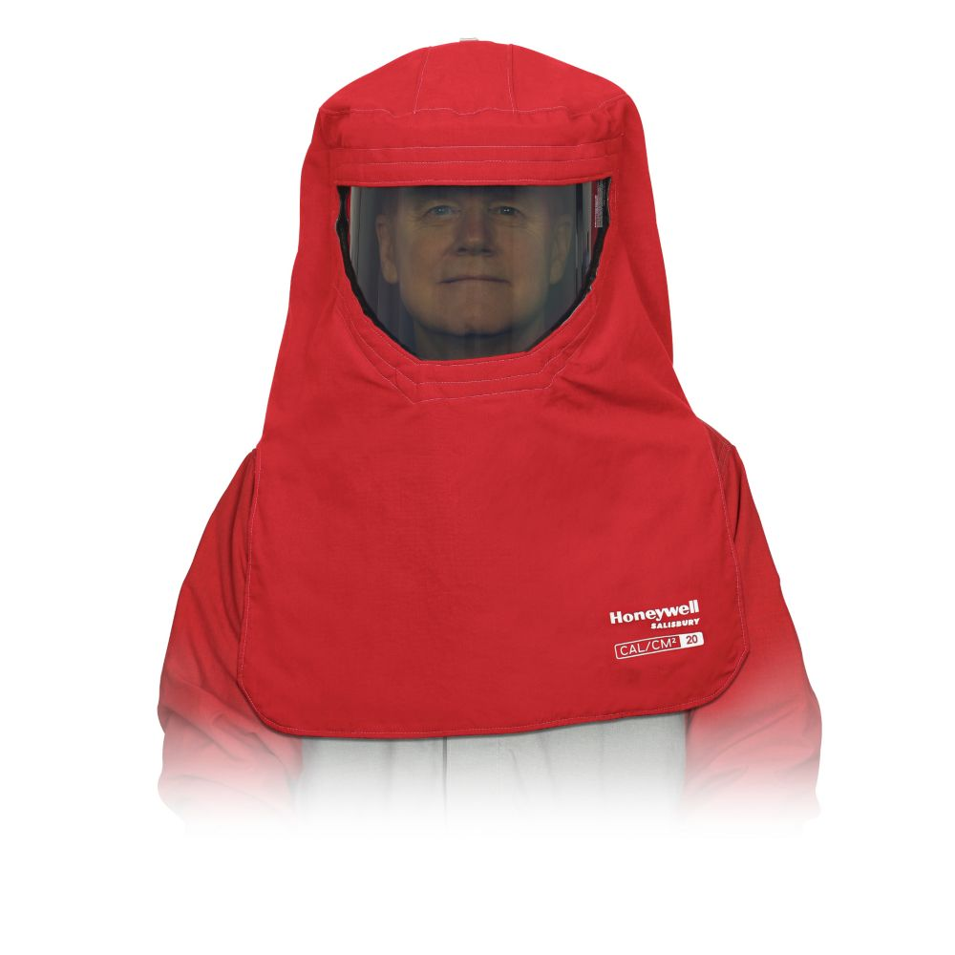
Honeywell

Slide 19
DuPont

Slide 20
Lindström Group

Slide 22
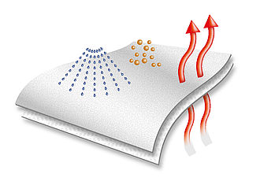
UVEX 4B
uvex 4B chemical protection suit
article number: 98375
type 4B (5/6) chemical protection, particle-tight and spray-tight
Polypropylene non woven laminated with Polyethylene film
colour: white, orange

Slide 23
3m Reusable PPE Kit

Slide 25
REFERENCES
https://www.who.int/medical_devices/WHO_coverall_comparison_table.pdf?ua=1
https://www.ncbi.nlm.nih.gov/pmc/articles/PMC4791533/
https://www.businesswire.com/news/home/20160905005103/en/Top-9-Vendors-Personal-Protective-Equipment-Market
https://www.shponline.co.uk/ppe-personal-protective-equipment/
https://www.mohfw.gov.in/pdf/GuidelinesonrationaluseofPersonalProtectiveEquipment.pdf
https://www.uvex-safety.com/en/products/protective-clothing-and-workwear/7291/uvex-4b-chemical-protection-suit/

